Slide 1
Decomposition 기법을 이용한 Object Detection Model의 속도, 전력 개선
Seonghye Han
Embedded Software Lab.

Slide 2
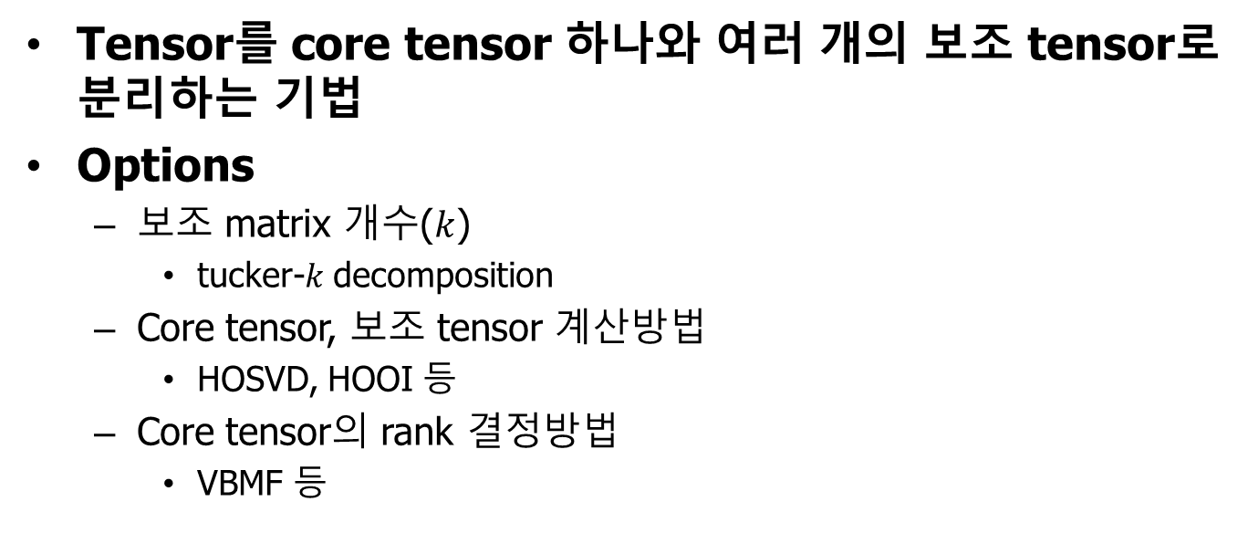

Tucker Decomposition
Tensor를 core tensor 하나와 여러 개의 보조 tensor로 분리하는 기법
Options
보조 matrix 개수($k$)
tucker-$k$ decomposition
Core tensor, 보조 tensor 계산방법
HOSVD, HOOI 등
Core tensor의 rank 결정방법
VBMF 등
$$x≈g×A×B×C$$
Notes:
Core tensor, 보조 tensor 곱이 원래 tensor와 비슷해지게 함.

Slide 3
Decomposition
Pytorch를 이용해 구현된 opensource
https://github.com/jacobgil/pytorch-tensor-decompositions
VGG16 model에 CP, tucker decomposition 구현
모델 training, decomposition, fine-tune tool 제공
Tucker decomposition의 경우
각 convolution layer에 대해 decomposition 적용
Tucker-2 decomposition
HOOI
VBMF

Slide 4
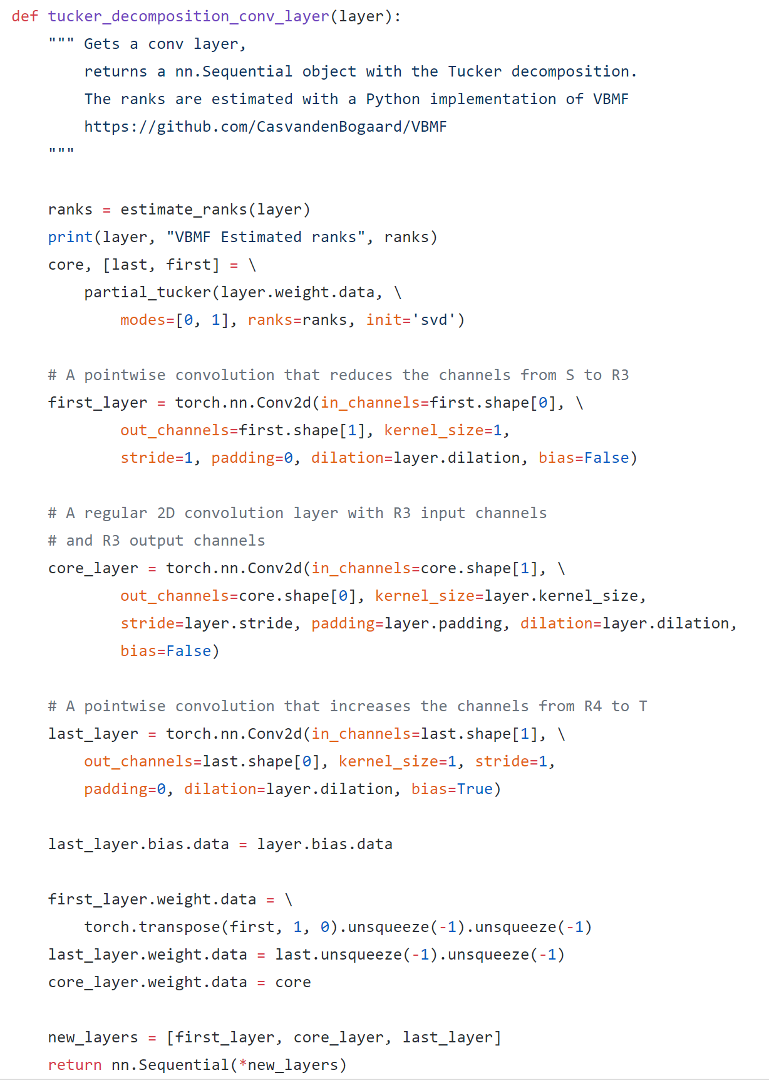
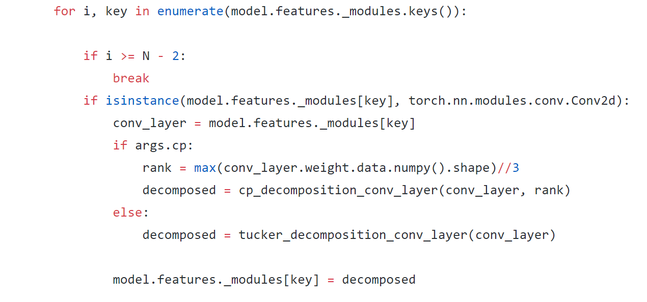
Decomposition
VBMF로 core tensor shape 결정
HOOI method로 decomposition

Slide 5
Decomposition
기존 VGG16 Model
Decomposition 적용 Model
ModifiedVGG16Model(
(features): Sequential(
(0): Conv2d(3, 64, kernel_size=(3, 3), stride=(1, 1), padding=(1, 1))
(1): ReLU(inplace)
(2): Conv2d(64, 64, kernel_size=(3, 3), stride=(1, 1), padding=(1, 1))
(3): ReLU(inplace)
(4): MaxPool2d(kernel_size=2, stride=2, padding=0, dilation=1, ceil_mode=False)
(5): Conv2d(64, 128, kernel_size=(3, 3), stride=(1, 1), padding=(1, 1))
(6): ReLU(inplace)
(7): Conv2d(128, 128, kernel_size=(3, 3), stride=(1, 1), padding=(1, 1))
(8): ReLU(inplace)
(9): MaxPool2d(kernel_size=2, stride=2, padding=0, dilation=1, ceil_mode=False)
(10): Conv2d(128, 256, kernel_size=(3, 3), stride=(1, 1), padding=(1, 1))
(11): ReLU(inplace)
(12): Conv2d(256, 256, kernel_size=(3, 3), stride=(1, 1), padding=(1, 1))
(13): ReLU(inplace)
(14): Conv2d(256, 256, kernel_size=(3, 3), stride=(1, 1), padding=(1, 1))
(15): ReLU(inplace)
(16): MaxPool2d(kernel_size=2, stride=2, padding=0, dilation=1, ceil_mode=False)
(17): Conv2d(256, 512, kernel_size=(3, 3), stride=(1, 1), padding=(1, 1))
(18): ReLU(inplace)
(19): Conv2d(512, 512, kernel_size=(3, 3), stride=(1, 1), padding=(1, 1))
(20): ReLU(inplace)
(21): Conv2d(512, 512, kernel_size=(3, 3), stride=(1, 1), padding=(1, 1))
(22): ReLU(inplace)
(23): MaxPool2d(kernel_size=2, stride=2, padding=0, dilation=1, ceil_mode=False)
(24): Conv2d(512, 512, kernel_size=(3, 3), stride=(1, 1), padding=(1, 1))
(25): ReLU(inplace)
(26): Conv2d(512, 512, kernel_size=(3, 3), stride=(1, 1), padding=(1, 1))
(27): ReLU(inplace)
(28): Conv2d(512, 512, kernel_size=(3, 3), stride=(1, 1), padding=(1, 1))
(29): ReLU(inplace)
(30): MaxPool2d(kernel_size=2, stride=2, padding=0, dilation=1, ceil_mode=False)
)
(classifier): Sequential(
(0): Dropout(p=0.5)
(1): Linear(in_features=25088, out_features=4096, bias=True)
(2): ReLU(inplace)
(3): Dropout(p=0.5)
(4): Linear(in_features=4096, out_features=4096, bias=True)
(5): ReLU(inplace)
(6): Linear(in_features=4096, out_features=2, bias=True)
)
)
DataParallel(
(module): ModifiedVGG16Model(
(features): Sequential(
(0): Sequential(
(0): Conv2d(3, 2, kernel_size=(1, 1), stride=(1, 1), bias=False)
(1): Conv2d(2, 14, kernel_size=(3, 3), stride=(1, 1), padding=(1, 1), bias=False)
(2): Conv2d(14, 64, kernel_size=(1, 1), stride=(1, 1))
)
(1): ReLU(inplace)
(2): Sequential(
(0): Conv2d(64, 29, kernel_size=(1, 1), stride=(1, 1), bias=False)
(1): Conv2d(29, 26, kernel_size=(3, 3), stride=(1, 1), padding=(1, 1), bias=False)
(2): Conv2d(26, 64, kernel_size=(1, 1), stride=(1, 1))
)
(3): ReLU(inplace)
(4): MaxPool2d(kernel_size=2, stride=2, padding=0, dilation=1, ceil_mode=False)
(5): Sequential(
(0): Conv2d(64, 32, kernel_size=(1, 1), stride=(1, 1), bias=False)
(1): Conv2d(32, 39, kernel_size=(3, 3), stride=(1, 1), padding=(1, 1), bias=False)
(2): Conv2d(39, 128, kernel_size=(1, 1), stride=(1, 1))
)
(6): ReLU(inplace)
(7): Sequential(
(0): Conv2d(128, 43, kernel_size=(1, 1), stride=(1, 1), bias=False)
(1): Conv2d(43, 42, kernel_size=(3, 3), stride=(1, 1), padding=(1, 1), bias=False)
(2): Conv2d(42, 128, kernel_size=(1, 1), stride=(1, 1))
)
(8): ReLU(inplace)
(9): MaxPool2d(kernel_size=2, stride=2, padding=0, dilation=1, ceil_mode=False)
(10): Sequential(
(0): Conv2d(128, 59, kernel_size=(1, 1), stride=(1, 1), bias=False)
(1): Conv2d(59, 71, kernel_size=(3, 3), stride=(1, 1), padding=(1, 1), bias=False)
(2): Conv2d(71, 256, kernel_size=(1, 1), stride=(1, 1))
)
(11): ReLU(inplace)
(12): Sequential(
(0): Conv2d(256, 81, kernel_size=(1, 1), stride=(1, 1), bias=False)
(1): Conv2d(81, 78, kernel_size=(3, 3), stride=(1, 1), padding=(1, 1), bias=False)
(2): Conv2d(78, 256, kernel_size=(1, 1), stride=(1, 1))
)
(13): ReLU(inplace)
(14): Sequential(
(0): Conv2d(256, 73, kernel_size=(1, 1), stride=(1, 1), bias=False)
(1): Conv2d(73, 70, kernel_size=(3, 3), stride=(1, 1), padding=(1, 1), bias=False)
(2): Conv2d(70, 256, kernel_size=(1, 1), stride=(1, 1))
)
(15): ReLU(inplace)
(16): MaxPool2d(kernel_size=2, stride=2, padding=0, dilation=1, ceil_mode=False)
(17): Sequential(
(0): Conv2d(256, 110, kernel_size=(1, 1), stride=(1, 1), bias=False)
(1): Conv2d(110, 131, kernel_size=(3, 3), stride=(1, 1), padding=(1, 1), bias=False)
(2): Conv2d(131, 512, kernel_size=(1, 1), stride=(1, 1))
)
(18): ReLU(inplace)
(19): Sequential(
(0): Conv2d(512, 148, kernel_size=(1, 1), stride=(1, 1), bias=False)
(1): Conv2d(148, 138, kernel_size=(3, 3), stride=(1, 1), padding=(1, 1), bias=False)
(2): Conv2d(138, 512, kernel_size=(1, 1), stride=(1, 1))
)
(20): ReLU(inplace)
(21): Sequential(
(0): Conv2d(512, 132, kernel_size=(1, 1), stride=(1, 1), bias=False)
(1): Conv2d(132, 121, kernel_size=(3, 3), stride=(1, 1), padding=(1, 1), bias=False)
(2): Conv2d(121, 512, kernel_size=(1, 1), stride=(1, 1))
)
(22): ReLU(inplace)
(23): MaxPool2d(kernel_size=2, stride=2, padding=0, dilation=1, ceil_mode=False)
(24): Sequential(
(0): Conv2d(512, 157, kernel_size=(1, 1), stride=(1, 1), bias=False)
(1): Conv2d(157, 144, kernel_size=(3, 3), stride=(1, 1), padding=(1, 1), bias=False)
(2): Conv2d(144, 512, kernel_size=(1, 1), stride=(1, 1))
)
(25): ReLU(inplace)
(26): Sequential(
(0): Conv2d(512, 149, kernel_size=(1, 1), stride=(1, 1), bias=False)
(1): Conv2d(149, 147, kernel_size=(3, 3), stride=(1, 1), padding=(1, 1), bias=False)
(2): Conv2d(147, 512, kernel_size=(1, 1), stride=(1, 1))
)
(27): ReLU(inplace)
(28): Sequential(
(0): Conv2d(512, 155, kernel_size=(1, 1), stride=(1, 1), bias=False)
(1): Conv2d(155, 152, kernel_size=(3, 3), stride=(1, 1), padding=(1, 1), bias=False)
(2): Conv2d(152, 512, kernel_size=(1, 1), stride=(1, 1))
)
(29): ReLU(inplace)
(30): MaxPool2d(kernel_size=2, stride=2, padding=0, dilation=1, ceil_mode=False)
)
(classifier): Sequential(
(0): Dropout(p=0.5)
(1): Linear(in_features=25088, out_features=4096, bias=True)
(2): ReLU(inplace)
(3): Dropout(p=0.5)
(4): Linear(in_features=4096, out_features=4096, bias=True)
(5): ReLU(inplace)
(6): Linear(in_features=4096, out_features=2, bias=True)
)
)
)
(128, 128) tensor
decompose
(0): (128, 43) 보조 tensor
(1): (43, 42) core tensor
(2): (42, 128) 보조 tensor

Slide 6
SSD
Pytorch를 이용해 구현된 opensource
https://github.com/amdegroot/ssd.pytorch
VGG16 model 기반 SSD300model
모델 training, evaluation tool 제공
VOC2007, 2012, COCO dataset

Slide 7
SSD
VGG
Net: SSD(
(vgg): ModuleList(
(0): Conv2d(3, 64, kernel_size=(3, 3), stride=(1, 1), padding=(1, 1))
(1): ReLU(inplace)
(2): Conv2d(64, 64, kernel_size=(3, 3), stride=(1, 1), padding=(1, 1))
(3): ReLU(inplace)
(4): MaxPool2d(kernel_size=2, stride=2, padding=0, dilation=1, ceil_mode=False)
(5): Conv2d(64, 128, kernel_size=(3, 3), stride=(1, 1), padding=(1, 1))
(6): ReLU(inplace)
(7): Conv2d(128, 128, kernel_size=(3, 3), stride=(1, 1), padding=(1, 1))
(8): ReLU(inplace)
(9): MaxPool2d(kernel_size=2, stride=2, padding=0, dilation=1, ceil_mode=False)
(10): Conv2d(128, 256, kernel_size=(3, 3), stride=(1, 1), padding=(1, 1))
(11): ReLU(inplace)
(12): Conv2d(256, 256, kernel_size=(3, 3), stride=(1, 1), padding=(1, 1))
(13): ReLU(inplace)
(14): Conv2d(256, 256, kernel_size=(3, 3), stride=(1, 1), padding=(1, 1))
(15): ReLU(inplace)
(16): MaxPool2d(kernel_size=2, stride=2, padding=0, dilation=1, ceil_mode=True)
(17): Conv2d(256, 512, kernel_size=(3, 3), stride=(1, 1), padding=(1, 1))
(18): ReLU(inplace)
(19): Conv2d(512, 512, kernel_size=(3, 3), stride=(1, 1), padding=(1, 1))
(20): ReLU(inplace)
(21): Conv2d(512, 512, kernel_size=(3, 3), stride=(1, 1), padding=(1, 1))
(22): ReLU(inplace)
(23): MaxPool2d(kernel_size=2, stride=2, padding=0, dilation=1, ceil_mode=False)
(24): Conv2d(512, 512, kernel_size=(3, 3), stride=(1, 1), padding=(1, 1))
(25): ReLU(inplace)
(26): Conv2d(512, 512, kernel_size=(3, 3), stride=(1, 1), padding=(1, 1))
(27): ReLU(inplace)
(28): Conv2d(512, 512, kernel_size=(3, 3), stride=(1, 1), padding=(1, 1))
(29): ReLU(inplace)
(30): MaxPool2d(kernel_size=3, stride=1, padding=1, dilation=1, ceil_mode=False)
(31): Conv2d(512, 1024, kernel_size=(3, 3), stride=(1, 1), padding=(6, 6), dilation=(6, 6))
(32): ReLU(inplace)
(33): Conv2d(1024, 1024, kernel_size=(1, 1), stride=(1, 1))
(34): ReLU(inplace)
)
extra
(L2Norm): L2Norm()
(extras): ModuleList(
(0): Conv2d(1024, 256, kernel_size=(1, 1), stride=(1, 1))
(1): Conv2d(256, 512, kernel_size=(3, 3), stride=(2, 2), padding=(1, 1))
(2): Conv2d(512, 128, kernel_size=(1, 1), stride=(1, 1))
(3): Conv2d(128, 256, kernel_size=(3, 3), stride=(2, 2), padding=(1, 1))
(4): Conv2d(256, 128, kernel_size=(1, 1), stride=(1, 1))
(5): Conv2d(128, 256, kernel_size=(3, 3), stride=(1, 1))
(6): Conv2d(256, 128, kernel_size=(1, 1), stride=(1, 1))
(7): Conv2d(128, 256, kernel_size=(3, 3), stride=(1, 1))
)
(loc): ModuleList(
(0): Conv2d(512, 16, kernel_size=(3, 3), stride=(1, 1), padding=(1, 1))
(1): Conv2d(1024, 24, kernel_size=(3, 3), stride=(1, 1), padding=(1, 1))
(2): Conv2d(512, 24, kernel_size=(3, 3), stride=(1, 1), padding=(1, 1))
(3): Conv2d(256, 24, kernel_size=(3, 3), stride=(1, 1), padding=(1, 1))
(4): Conv2d(256, 16, kernel_size=(3, 3), stride=(1, 1), padding=(1, 1))
(5): Conv2d(256, 16, kernel_size=(3, 3), stride=(1, 1), padding=(1, 1))
)
(conf): ModuleList(
(0): Conv2d(512, 84, kernel_size=(3, 3), stride=(1, 1), padding=(1, 1))
(1): Conv2d(1024, 126, kernel_size=(3, 3), stride=(1, 1), padding=(1, 1))
(2): Conv2d(512, 126, kernel_size=(3, 3), stride=(1, 1), padding=(1, 1))
(3): Conv2d(256, 126, kernel_size=(3, 3), stride=(1, 1), padding=(1, 1))
(4): Conv2d(256, 84, kernel_size=(3, 3), stride=(1, 1), padding=(1, 1))
(5): Conv2d(256, 84, kernel_size=(3, 3), stride=(1, 1), padding=(1, 1))
)
(softmax): Softmax()
)
localization
confidence

Slide 8
Apply decomposition method
Training
SSD model을 사용
Decomposition
Model의 각 convolution layer를 tucker-2 decomposition을 이용해 3개의 sequential layers로 치환
Fine tuning
변경된 SSD model을 재학습해 accuracy회복

Slide 9
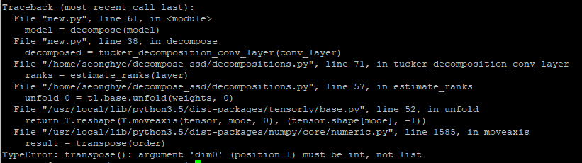
Apply decomposition method
tucker_decomposition_conv_layer
estimate_ranks
unfold
reshape
moveaxis
rank selection 부분에서 error 발생

Slide 10
진행 계획
대표적 Object Detection Model의 decomposition 성능 측정
Object Detection Model training
SSD, YOLO, SqueezeDet
Tucker decomposition 적용
Fine-tuning
Epoch 횟수를 늘려가며 accuracy 변화 관찰
Inference 실행 및 성능 측정 (edge device)
FLOPs, inference time, accuracy 측정
Further works
각 Object Detection Model의 decomposition 성능 비교 및 원인 분석
Decomposition 성능 향상을 위한 방법 고안

Slide 11
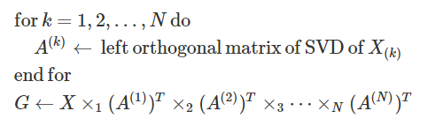
Appendix: Tucker Decomposition Options
HOSVD
Higher Order SVD
보조 tensor: 기존 tensor를 각 차원에 대해 unfolding
Core tensor: 기존 tensor, 보조 tensor를 이용해 계산

Slide 12
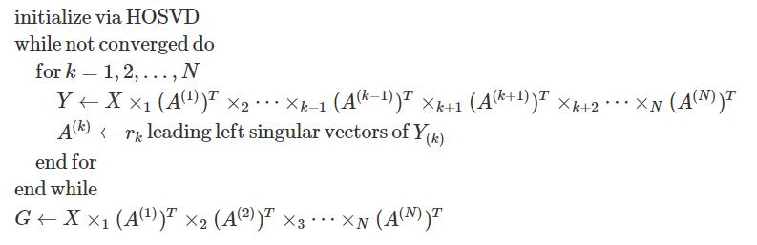
Appendix: Tucker Decomposition Options
HOOI
Higher Order Orthogonal Iteration
HOSVD이후 tuning을 통해 decomposition 결과를 original tensor와 가장 비슷하게 조정

